Slide 1
Westward Expansion: Georgia’s Growth & Development, 1789-1840
Mrs. Kim West
8th Grade Georgia Studies
GPS: SS8H5a
Chapter 6, Section 4

Slide 2
Enduring Understanding
Individuals, Groups, Institutions: The student will understand that the actions of individuals groups, and/or institutions affect society through intended and unintended consequences.
Production, Distribution, Consumption: The student will understand the productions, distribution, and consumption of good/services produced by the society are affected by the location, customs, beliefs, and laws of the society.

Slide 3
GPS
SS8H5 The student will explain significant factors that affected the development of Georgia as part of the growth of the United States between 1789 and 1840.
a. Explain the establishment of the University
of Georgia, Louisville, and the spread of Baptist and Methodist churches.

Slide 4
Essential Question
What role did the establishment of the University of Georgia, Louisville, the spread of Baptist and Methodist churches play in Georgia’s growth?

Slide 5
What was life like on the Georgia Frontier?
Undeveloped land in central and western Georgia.
Few settlers; much land given away in land lotteries.
Far-flung trading posts were only stores.
Often danger lurked from hostile attacks.
Social activities often centered around necessary work.
The country store became the center of activity; few luxuries were available.

Slide 6
What was life like in Georgia's Towns?
Cultural refinements (higher level living) set apart frontier and town lifestyles.
Newspapers, theater, and debate societies.
Fancy balls, barbecues, camp meetings, and horse racing.
Orphanages, hospitals, and facilities for people with special needs were operated.

Slide 7
University of Georgia
After the American Revolution, many Georgia’s were not educated.
The Governor Lyman Hall, recommend that the state set aside land to build schools, but few were built.
Even though very few Georgians were educated, they believed in the value of a good education.

Slide 8
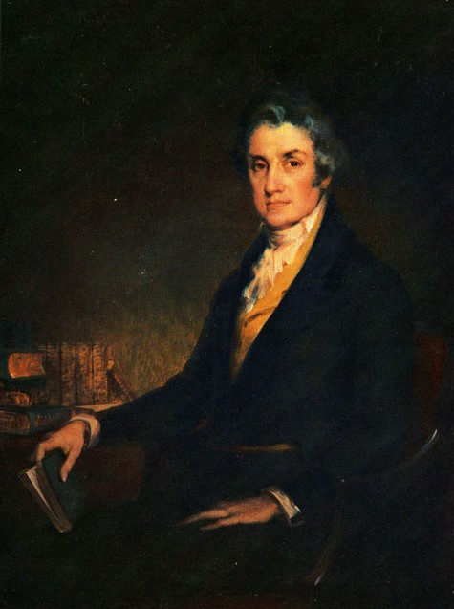
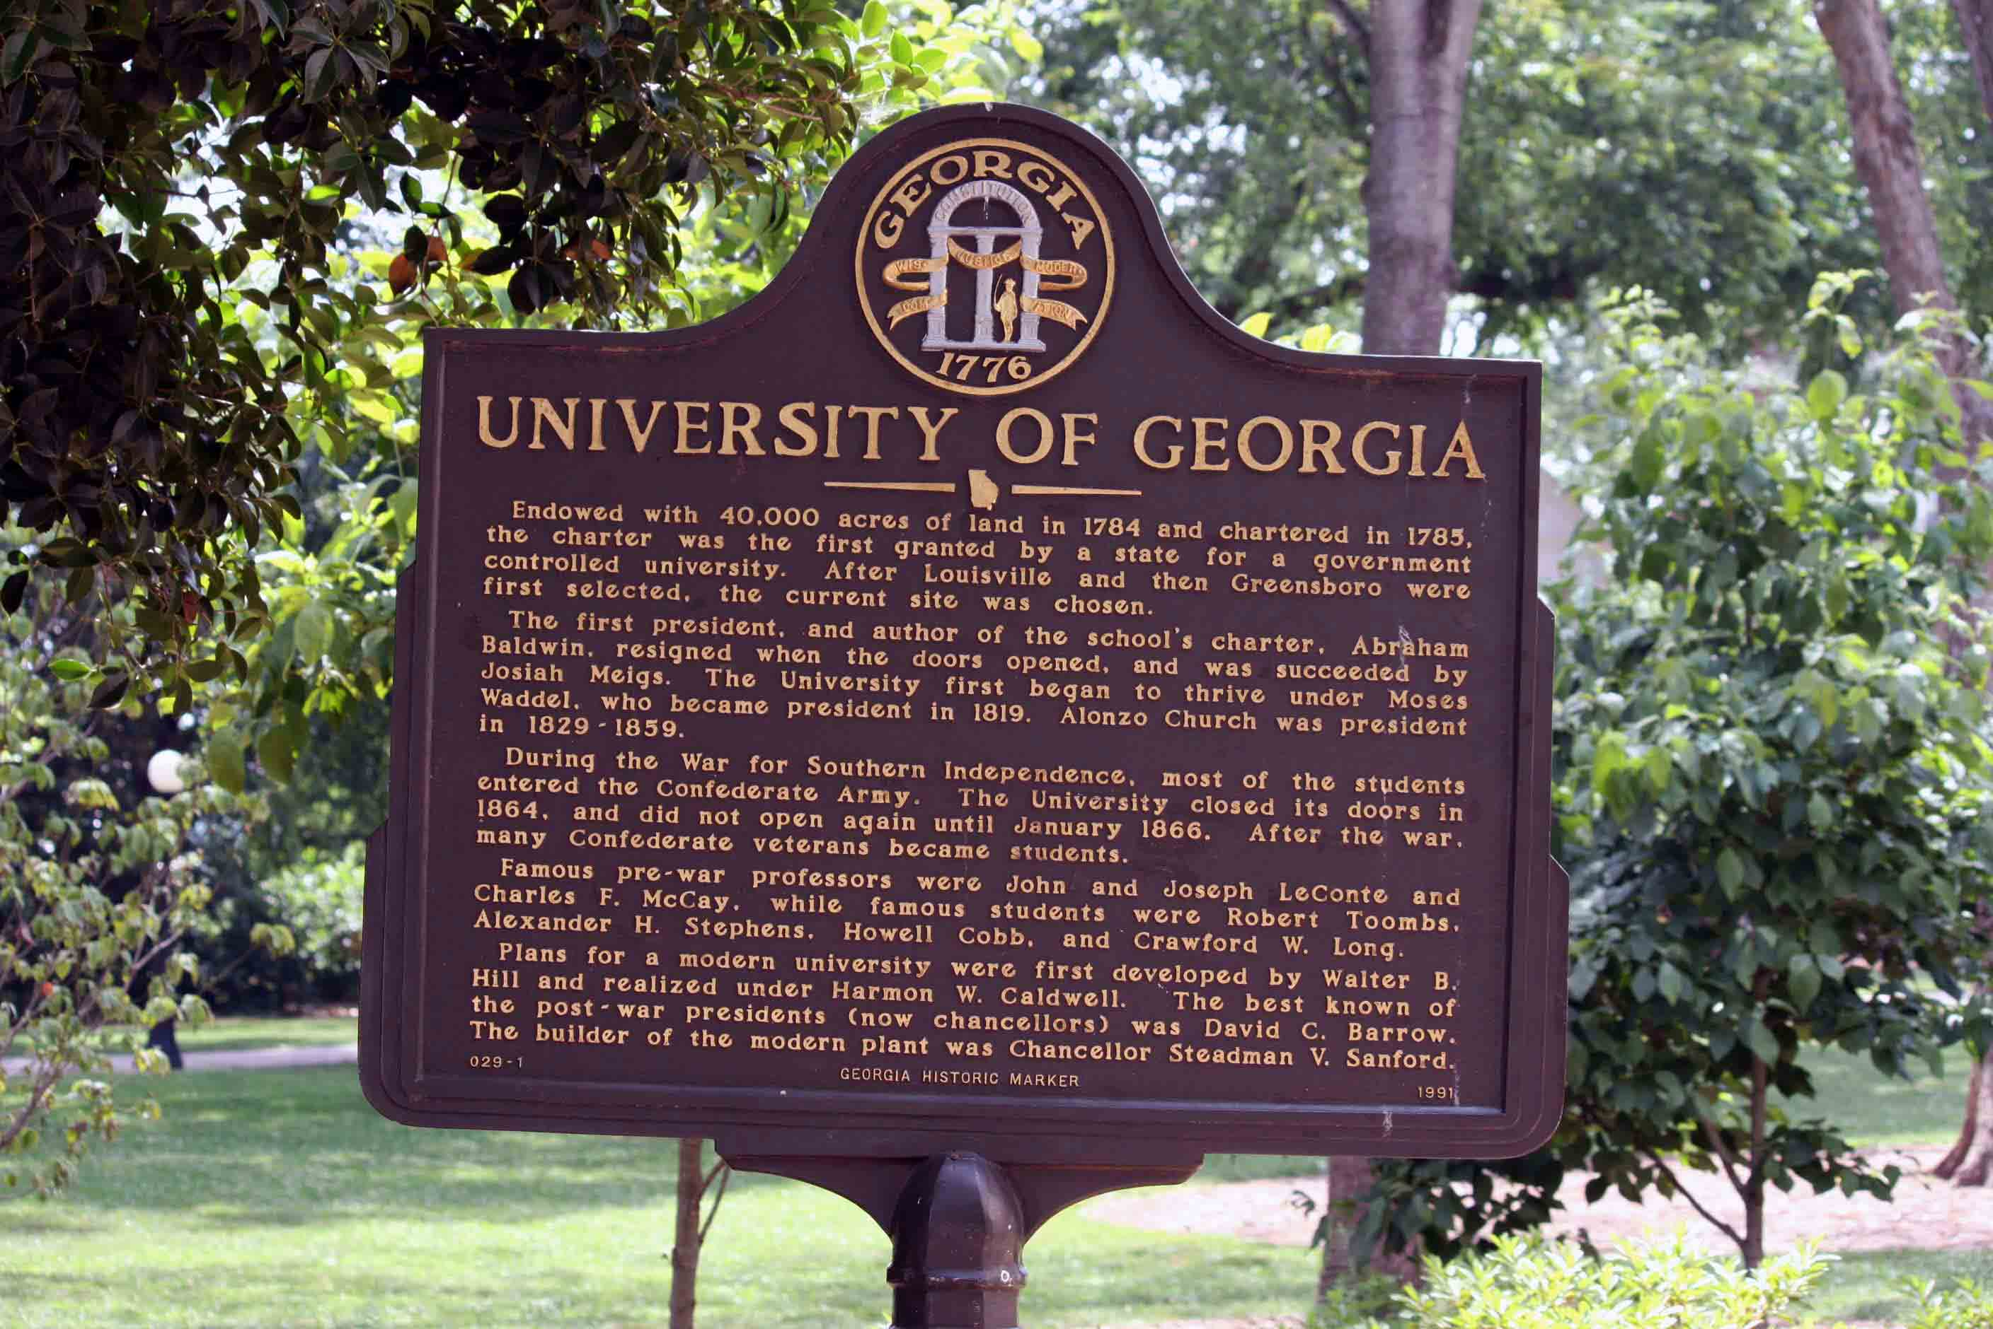
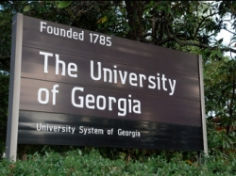
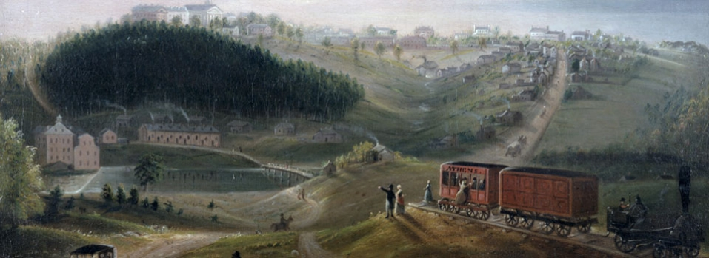

Slide 9
University of Georgia
In 1784, 20,000 acres of land, was set aside to build a state school.
In 1785, the University of Georgia was chartered (began) as a land grant university.
A land grant university is one in which the government donates the land to build the school.
Abraham Baldwin, signer of the US Constitution for Georgia, was UGA’s 1st president.

Slide 10
University of Georgia
UGA was the first land-grant school in the country.
It officially opened in 1801; women were not admitted until 1918.
UGA was often called Franklin College in its early days.

Slide 11
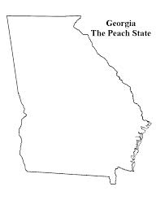
Louisville
Louisville was Georgia’s 3rd state capital, from 1796-1807.
At the time it was the center of Georgia’s population; this was driven by the state’s westward expansion.
The state’s legislators hoped that the town would also serve as a trading center due to its location on the Ogeechee River.
Augusta
Louisville
Savannah

Slide 12
Louisville
Once it was established, Louisville developed both socially and financially.
However, Louisville’s time as capital ended in 1807 due several factors including the malaria outbreaks.
One of the most famous events in the city was when the state legislators publically set fire to the Yazoo Land Act with a magnifying glass.
Augusta
Louisville
Savannah

Slide 13
Spread of Baptist & Methodist Churches
After the American Revolution, religion began to spread throughout the state.
Ministers began arriving in Georgia from Great Britain.
The founder of the Methodist church, John Wesley, preached in colonial Georgia.

Slide 14
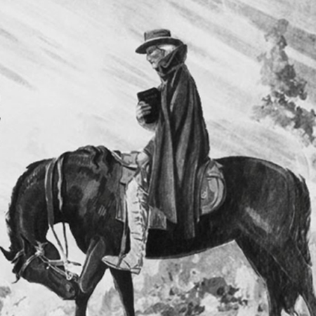
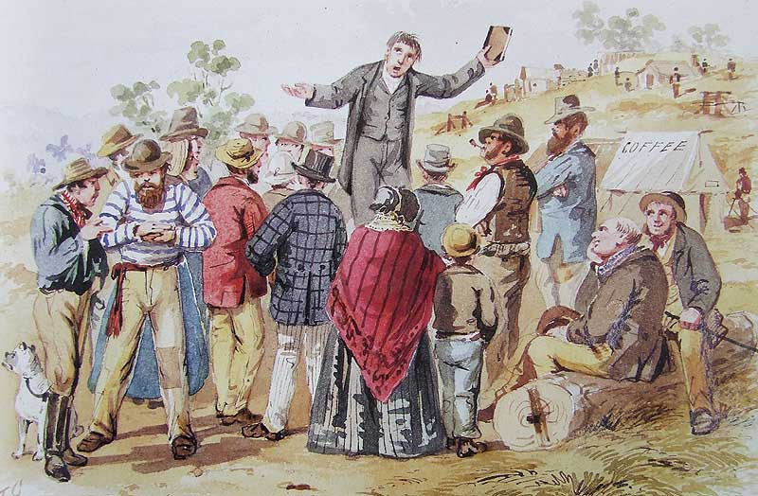
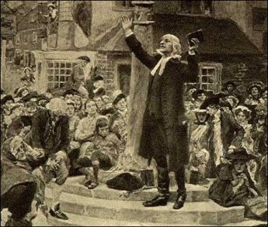

Slide 15
Spread of Baptist & Methodist Churches
Georgians did not begin identifying themselves with denominations until the Second Great Awakening.
The Second Great Awakening was a protestant revival movement during the early 19th century in the United States. Membership rose rapidly among Baptist and Methodist congregations whose preachers led the movement.

Slide 16
Spread of Baptist & Methodist Churches
Many slaves converted to the Methodist and Baptist faiths.
Both the Baptists and Methodists used revivals and camp meetings to help increase their membership.
These meetings were all day affairs where famers and other townspeople could listen to the sermon, but also get together and socialize with their friends and family after weeks of laboring on their farms.

Slide 17
Spread of Baptist & Methodist Churches
The Methodist church also incorporated the use of circuit riders, ministers who would ride from small town to small town and preach.
These circuit riders were important in bringing new converts to the church.

