Slide 1
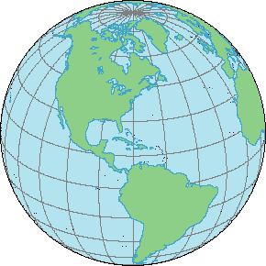
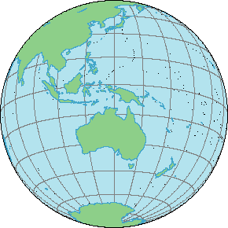
How many people does it take to make
an ordinary wooden pencil?
482
MONGOL
EBERHARD FABER
The International
Pencil

Slide 2
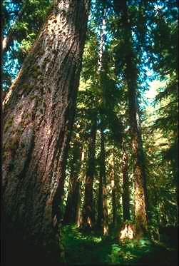
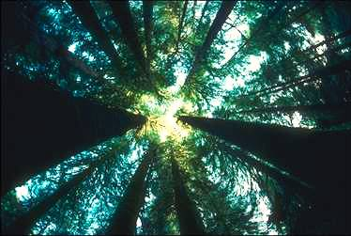
Cedar trees are used because their grain is very straight.

Slide 3
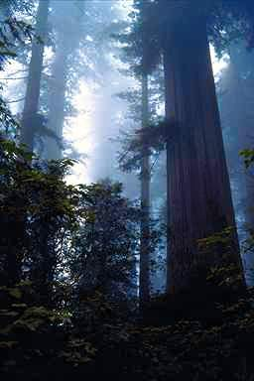
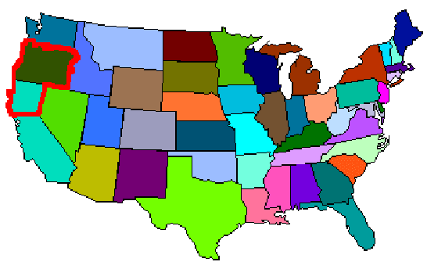
Lumber jacks in Oregon and northern California cut down cedar trees.

Slide 4
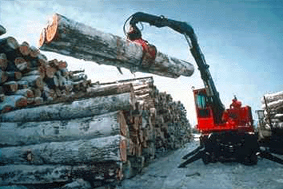
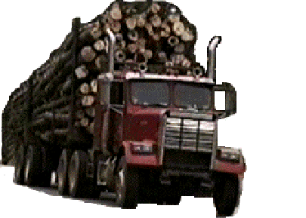
The logs are loaded onto trucks ...

Slide 5
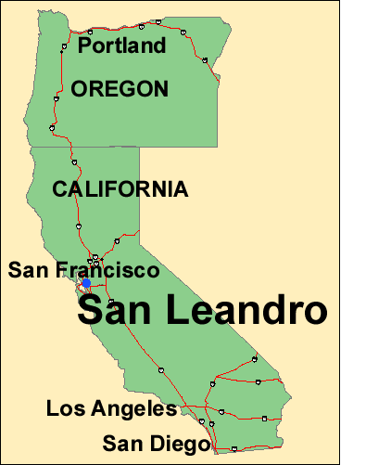
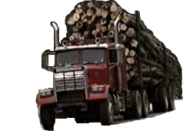
… and delivered to a mill in San Leandro California.

Slide 6
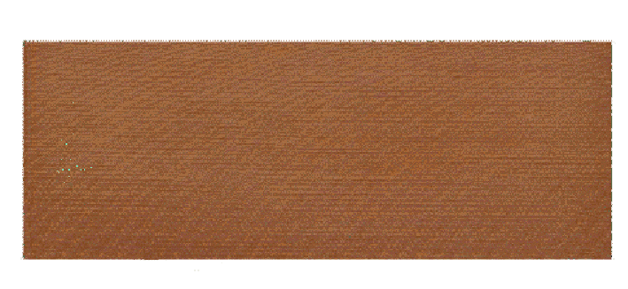
At the mill in San Leandro, the logs are cut into rectangular blocks called slats. Each slat is 7 inches (17.78 centimeters) long and 3 inches (7.62 centimeters) wide, and one-quarter inch (0.63 centimeters) thick -- half the thickness of a pencil.

Slide 7
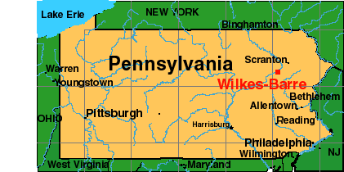
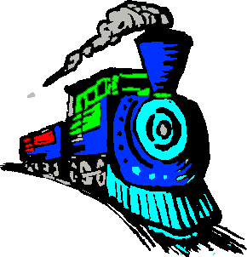
The slats are shipped by rail to a factory in Wilkes-Barre Pennsylvania.

Slide 8
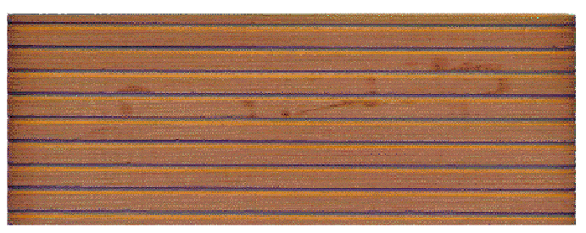
When they arrive at the factory, a machine cuts nine grooves into one side of each slat.

Slide 9
At the factory, resources from around the world are combined to make a pencil.
Pencil
482
MONGOL
EBERHARD FABER
Factory

Slide 10

Trucks run on diesel fuel.

Slide 11
Where do we get the crude oil needed to make diesel gas?

Slide 12
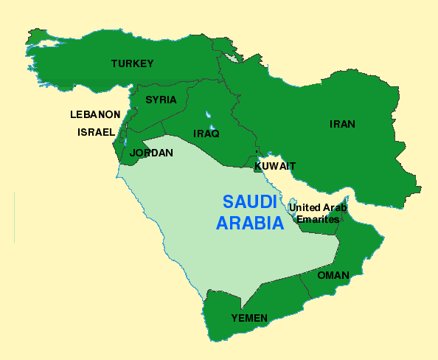

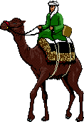
Much of the oil imported into the U.S. comes from OPEC countries like Saudi Arabia

Slide 13
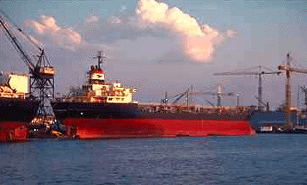
… is loaded on a ship in a paper sack ...

Slide 14
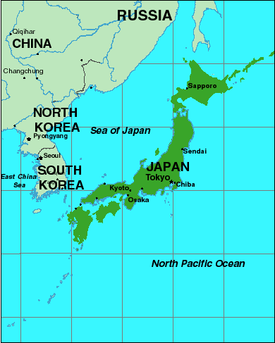

Workers in Japan built the ship that carries the graphite to the U.S.

Slide 15
The “lead” used in pencils is a mixture of
graphite, clay, and gums.
482
MONGOL
EBERHARD FABER

Slide 16
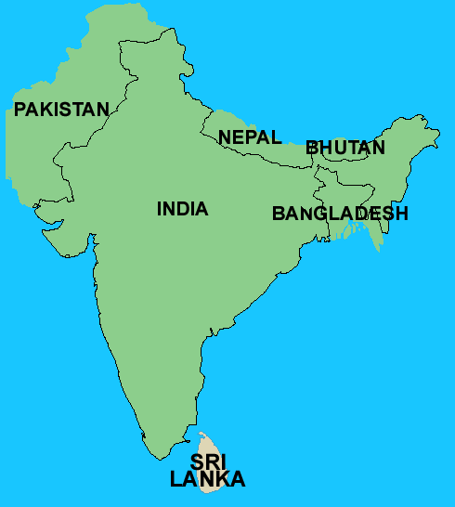
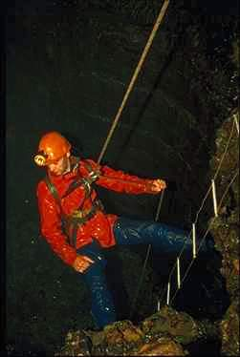
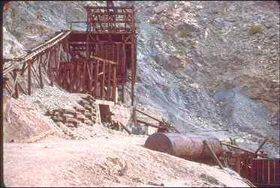
Graphite is mined in Sri Lanka

Slide 17
… and is shipped to the United States.

Slide 18
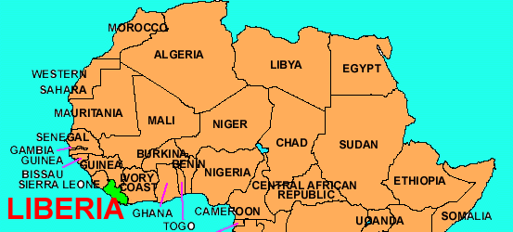
The ship is registered in Liberia.

Slide 19
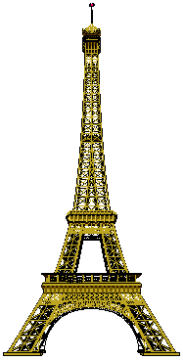
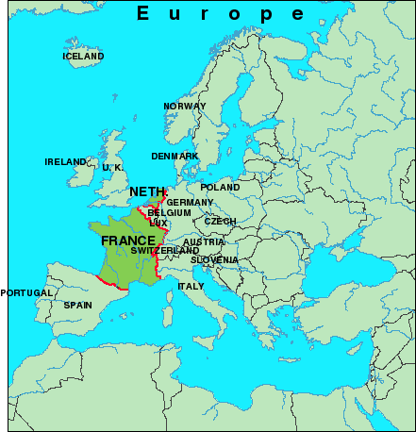
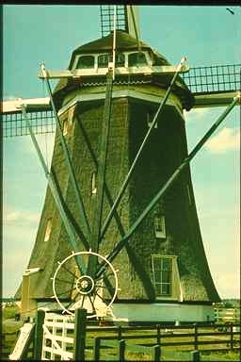
The ship is owned by a French-Dutch joint venture.

Slide 20
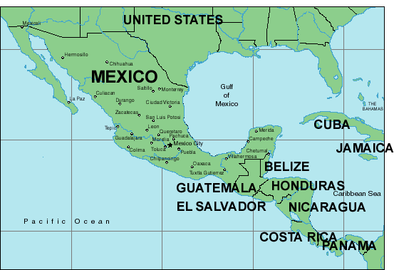
Candelilla wax from Mexico is added to make the pencil lead smooth and strong.

Slide 21
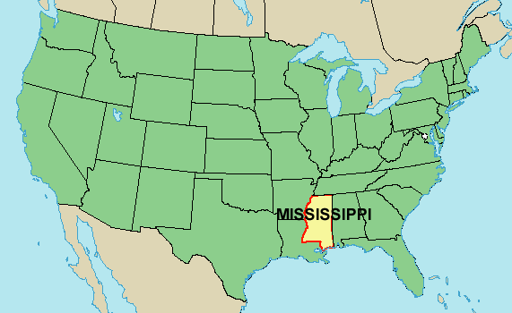
The graphite and candelilla wax are then
mixed with clay from Mississippi to make
the lead in the pencil.

Slide 22
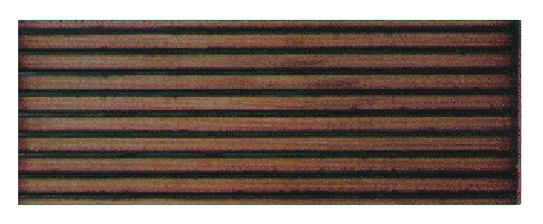
A machine puts this mixture of graphite, clay and wax into the grooves of a slat.

Slide 23
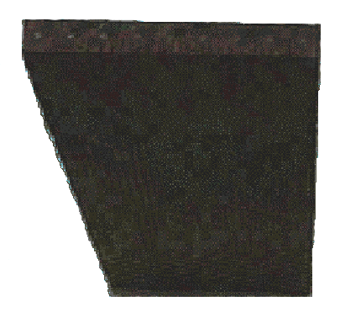
Then two slats are glued together to make a “pencil sandwich”.

Slide 24
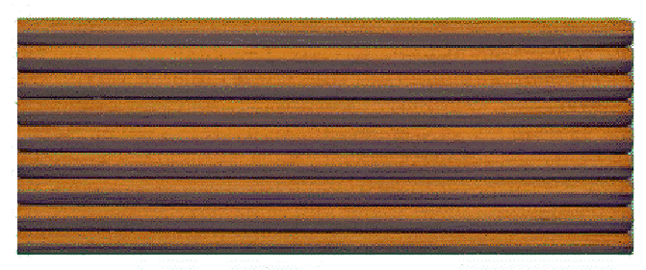
Nine pencils are carved out of each pencil sandwich.

Slide 25
Each pencil then receives several coats of lacquer.
482
MONGOL
EBERHARD FABER

Slide 26
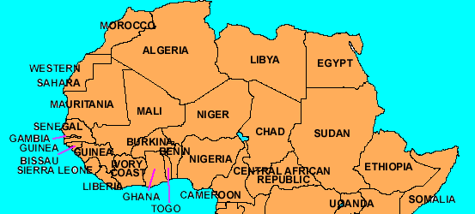
Castor oil is one of the main ingredients of lacquer. Farmers in tropical Africa grow castor beans

Slide 27

The black lettering on a pencil is a combination of carbon black and resins.
482
MONGOL
EBERHARD FABER

Slide 28
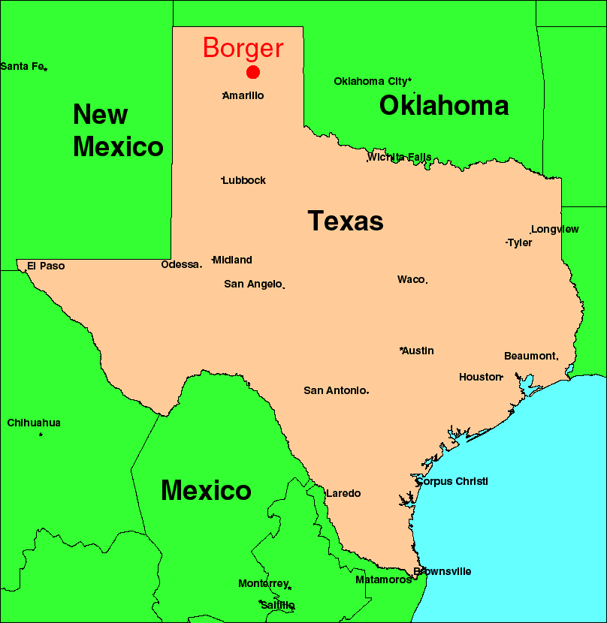
A plant in Borger, Texas, makes carbon black.

Slide 29
The piece of metal that holds the eraser is
called the ferrule. It is made of brass, which
is a combination of zinc and copper.
482
MONGOL
EBERHARD FABER
Two thirds of the world’s reserves of zinc are in
the U.S., Canada, Australia, the Former Soviet
Union, and Ireland.

Slide 30
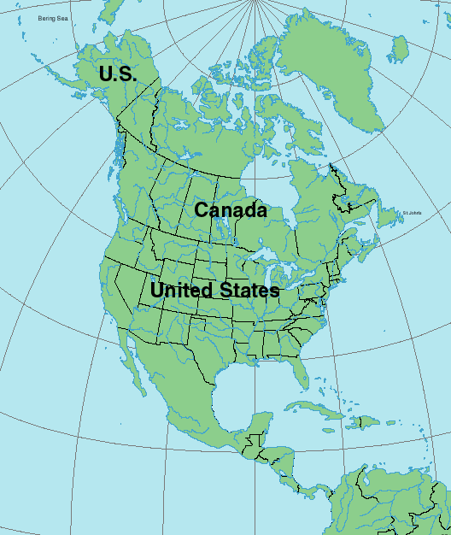
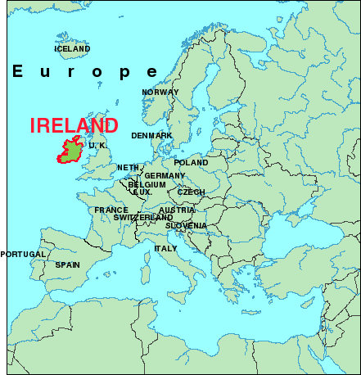

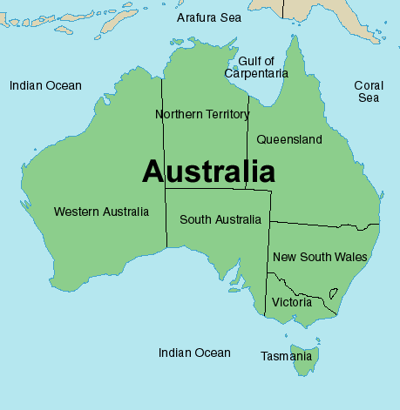
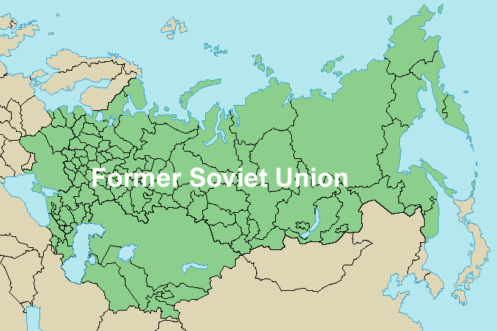
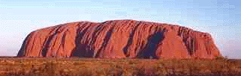

Slide 31
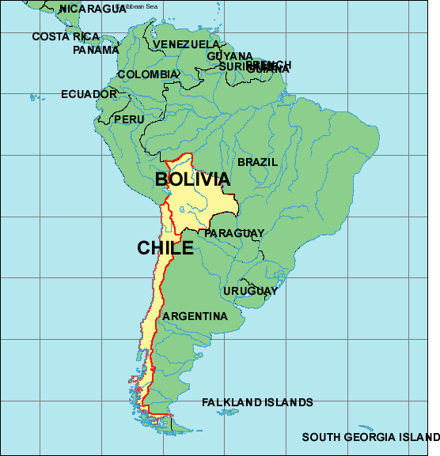
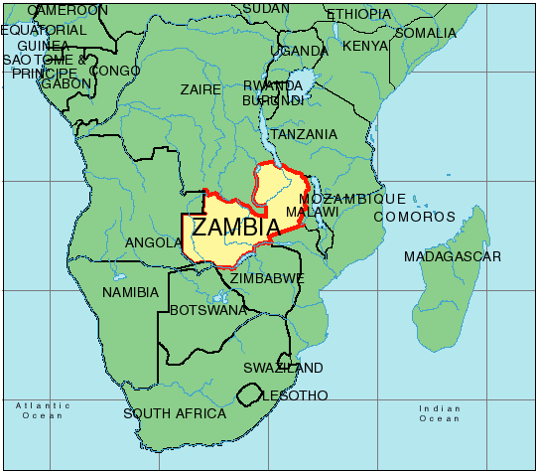
Sources of copper include Bolivia, Chile, and Zambia

Slide 32
The plug, or eraser, is a combination of many different ingredients including pumice from Italy.
EBERHARD FABER
MONGOL
482

Slide 33
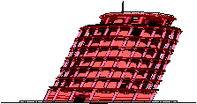
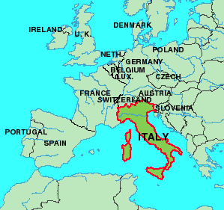

Slide 34
The substance that erases is the
result of a chemical reaction between
sulfur chloride and the oil from a seed
grown in Indonesia.
EBERHARD FABER
MONGOL
482

Slide 35
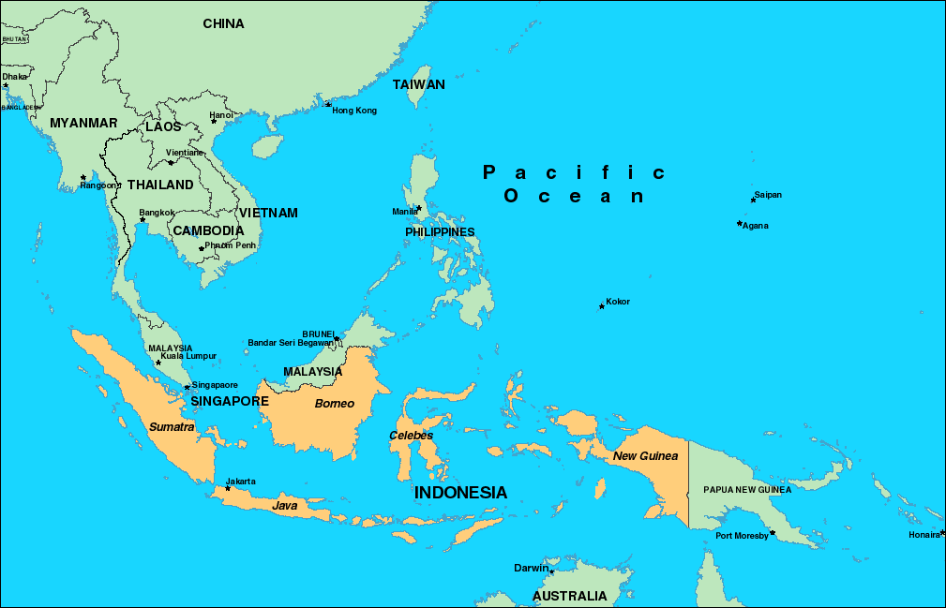

Slide 36
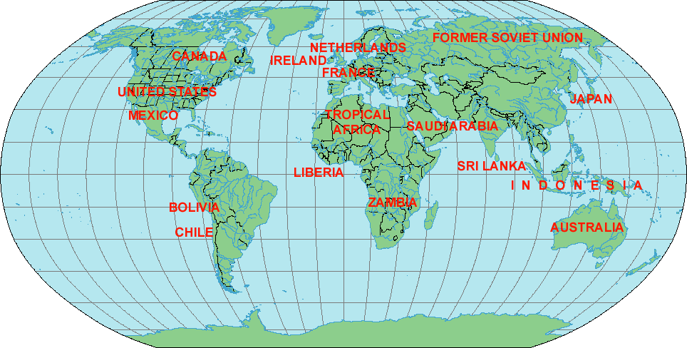
People from around the world are involved in making a pencil.
EBERHARD FABER
MONGOL
482

Slide 37
Written Response
Directions – Write a short paragraph (3-5 sentences) to answer each question.
Why do countries specialize in the creation of certain products?
How does this specialization encourage trade?

Slide 38
How many people participate in the production
of a pencil? Far more than anyone would
suspect. And only a few of those involved even
know that a pencil is the end result of their
labor. Through specialization, people from
around the world contribute to the end product.
Without even knowing it, they interact with each
other indirectly. How much does this pencil
cost? Less than a quarter -- far less than if any
single person tried to produce it with no one
else’s help. The international pencil is a bargain.

