Slide 1
1920-1945: The Impact of the Great Depression of Georgia (Chapter 11)

Slide 2
GPS
SS8H8 The student will analyze the important events that occurred after World War I and their impact on Georgia.
a. Describe the impact of the boll weevil and drought on Georgia.
b. Explain economic factors that resulted in the Great Depression.
SSE1 The student will give examples of the kinds of goods and services produced in Georgia in different historical periods.

Slide 3
Essential Questions
How did the boll weevil and the drought affect the economy of Georgia? E1
What specific economic problems in the south had Georgia in a negative economic situation even before the Great Depression? H8a
During the late teens of the 1900’s, what natural forces resulted in significant negative impact on the economy of the south? H8a
How did economic factors lead to the Great Depression? H8b

Slide 4
Georgia’s Famers Suffer Financially
During the 1920s through 1945 there were three main reasons Georgia’s economy suffered. Because Georgia’s economy was mainly based around agriculture the state’s farmers also suffered.
There were three main reasons the farmers suffered financially: the introduction of the boll weevil, drought and the Great Depression.

Slide 5
The Boll Weevil
The Boll Weevil:
Georgia’s major agricultural crop was almost destroyed in the 1920s.
The boll weevil insect ate most of Georgia’s cotton plants resulting in the loss of millions of acres of cotton.

Slide 6
The Boll Weevil
The primary damage to cotton occurs when female boll weevils deposit eggs in fruiting structures on developing cotton plants.
The boll weevil comes from Mexico and could be found through many other southern states such as Texas and Louisiana.
Even today Georgia farmers are fighting to keep the boll weevil out of Georgia through the use of chemical insecticides and traps.

Slide 7
The Boll Weevil
Farmers were losing money because their crops were destroyed.
Price of cotton also dropped because there was little demand for it.
Farmers were also hurt because during World War I there was a huge demand for cotton and farmers were getting paid as much as 3 times the normal rate for cotton (the cotton was used to make clothing for the soldiers). Because of the high demand cotton became the “King” crop in Georgia – King Cotton.

Slide 8
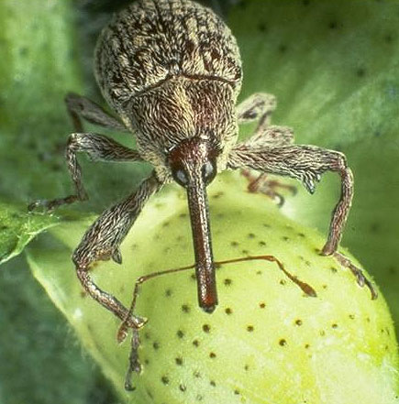
That’s One Ugly Beetle!

Slide 9
Drought in Georgia
In 1924-1925 a major drought (period with little or no rain) hit Georgia.
Many farmers gave up their farms in search of income. Some moved up north to the big urban centers of Chicago and Detroit.

Slide 10
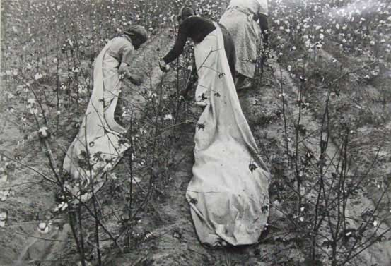
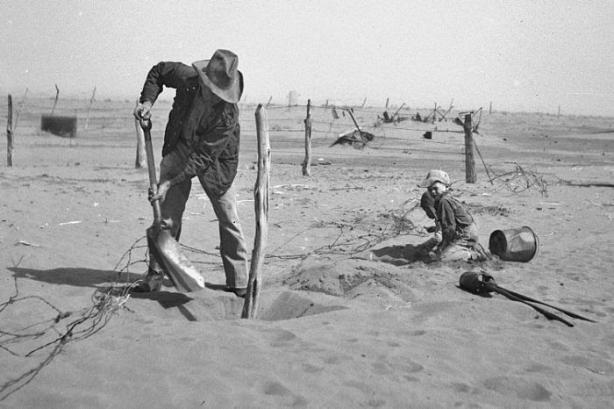

Slide 11
Drought in Georgia
Georgia farmers did not have the “good life” that many Americans enjoyed, but they survived and went on to grow other crops such as peanuts, tobacco, pecans, vegetables and chickens.
When farms closed they forced banks and farm-related business to close.

Slide 12
The Great Depression
Depression is an economic term which means a sustained, long-term downturn in economic activity in one or more areas (such as agriculture or manufacturing).
Economies usually have cycles of ups and downs (periods of prosperity and depression).
Ups (Prosperity) – jobs are available, businesses are hiring, people have money to spend on the things they “want,” not just what they “need.”

Slide 13
The Great Depression
Downs (Depression) – businesses are laying off workers because they are not needed, the demand for goods and services slows and people may have just enough money to purchase what they “need,” not what they “want.”
The Great Depression lasted 10 years (1929-1939).

Slide 14
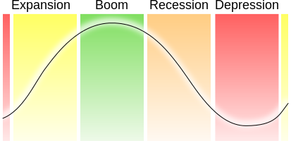
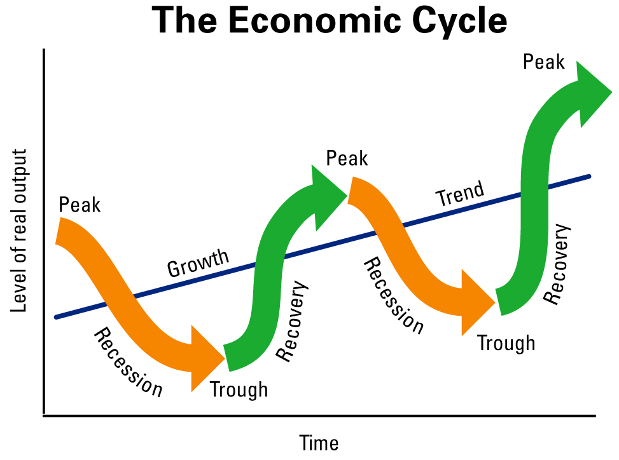

Slide 15
It started with a “Crash”
On October 29, 1929 the U.S. stock market “crashed” resulting a in a drop of stock prices. The day is referred to as “Black Tuesday.”
Millions of people lost most if not all of their wealth.
Example: U.S. Steel was $262 per share – dropped to $22 per share
Some stocks worth less than 1¢
The stock market is a place where shares of ownership in corporations (stock) are bought and sold.
Total losses by end of year: $40 billion.

Slide 16
Causes of the Depression
Many people had borrowed too much money that they could not afford to pay back.
Factories produced more goods than they could sell.
As people and businesses had problems making money, banks did not get paid for loans.
“Speculation” in the stock market: paying only a portion of the price of a stock hoping that the value will go up.

Slide 17
Causes of the Depression
Runs on banks: people were afraid they would lose their money if it was left in the bank so they took out all of their money.
laissez-faire: attitude that the economy would fix itself if left alone, a “wait and see” attitude.

Slide 18
Living Through the Depression
1932: 13 million unemployed
9,000 banks closed
31 Georgia banks failed
Hooverilles: named for President Hoover – shacks where homeless people gathered.
Soup kitchens set up by charities and governments to feed hungry.
Schools were often forced to close or shorten schedules.
Georgians were already suffering from economic problems before “Black Tuesday.”

Slide 19
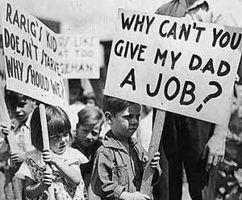
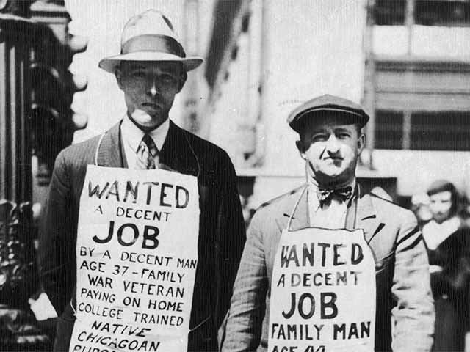
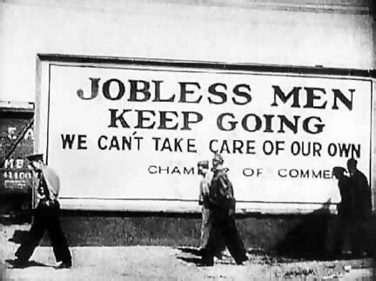
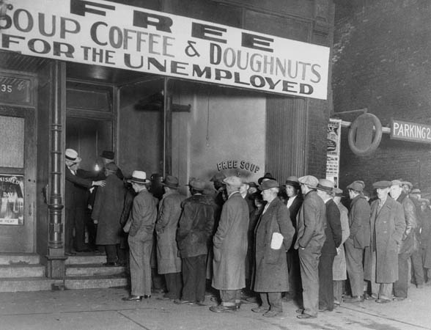

Slide 20
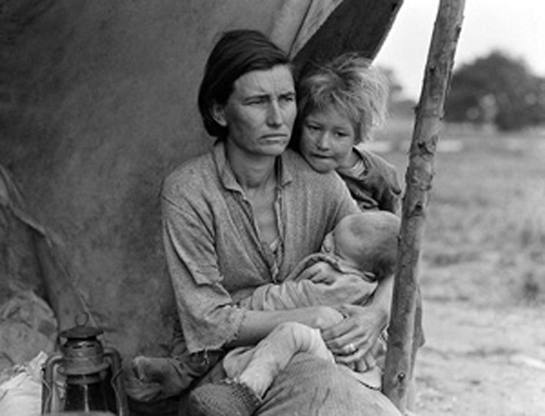
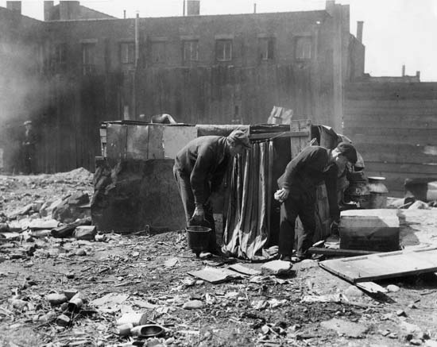

Slide 21
Easing the Burden
President Hoover’s plan: government would buy farmer’s crops to help raise the price.
Plan did not work, but the food and cotton were used to help the needy.
Another plan was to hire unemployed people to do work for the government.
Plan did not employ enough people to really help.

