Slide 1
Geography of Asia
Presented by…
Ms. C. Mason
7th Grade Social Studies

Slide 2
Asia is HUGE!
Asia contains:
Lots of mountain ranges
Many important rivers
Numerous island groups
Two major deserts
And vast expanses of land

Slide 3
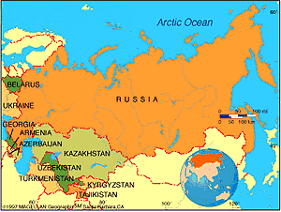
Asia is HUGE!
Russia is part of two separate continents!

Slide 4
Asia’s Mountain Ranges!
Asia’s mountain ranges include:
the Himalayas, which divide the Indian Subcontinent from the rest of Asia.
The Eastern and Western Ghats of India.
The Altai Mountains of Mongolia.

Slide 5
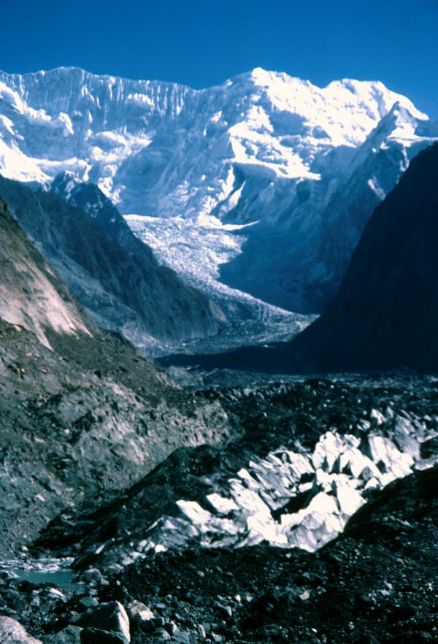
Asia’s Mountain Ranges!
Perhaps the grandest
feature of Asia is the
huge Himalayan Range.
The Himalayas, which
stretch 1,500 miles are
the highest mountains in
the world!

Slide 6
Asia’s Mountain Ranges!
The Himalayas contain great mineral wealth, with some of the largest deposits in the region of Kashmir.
This part of the Subcontinent is
highly prized and has been
fought over between Pakistan
and India, with China also taking
its share.

Slide 7
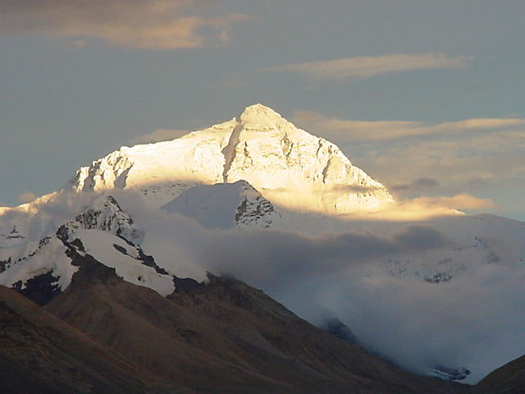
Asia’s Mountain Ranges! Mount Everest
Nine of the world’s
tallest mountains
over 26,000 feet in
elevation are found
in this range
including Mt.
Everest, the
world’s tallest mountain,
at almost 30,000 feet

Slide 8
Asia’s Deserts
Asia’s deserts are the Gobi in China and Mongolia and the Taklimakan of China.

Slide 9
Asia’s Major Rivers
Important rivers include:
The Huang He and the Chiang Jiang in China (some sources refer to these as the Yellow River and the Yangtze)
The Indus and the Ganges in India
The Brahmaputra in China and India
And the Mekong in Southeast Asia.

Slide 10
Asia’s Major Rivers
Asia’s rivers provide lush, fertile valleys where people have lived since ancient times!

Slide 11
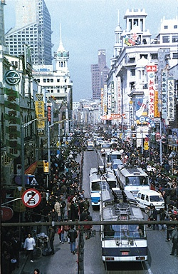
Asia’s Population
The largest concentration of people in Asia lives in China and India, the most populated countries in the world.
20% of the world’s population lives in China, but most people live in the eastern half of the country.

Slide 12
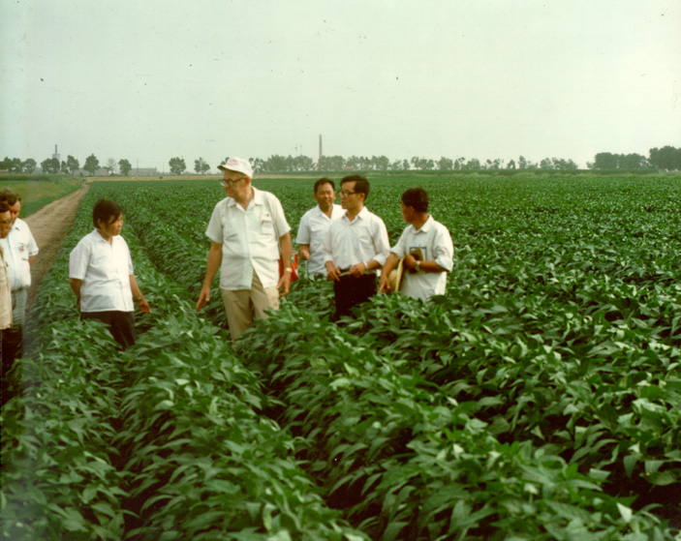
Why Do Most People Live in the Eastern Half of China?
Eastern China is rich in resources.
It has fertile soil .
It receives sufficient rainfall for farming.

Slide 13
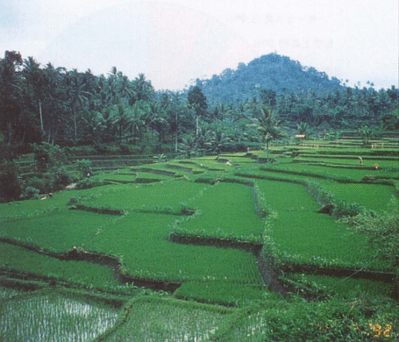
Agriculture in Asia
Agriculture is important not only as a means of livelihood but also for feeding the huge population!

Slide 14
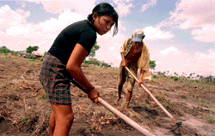
Agriculture in Asia
Many people throughout Asia live on small family farms and survive on subsistence agriculture which is often threatened by natural disasters that plague Asia.

Slide 15
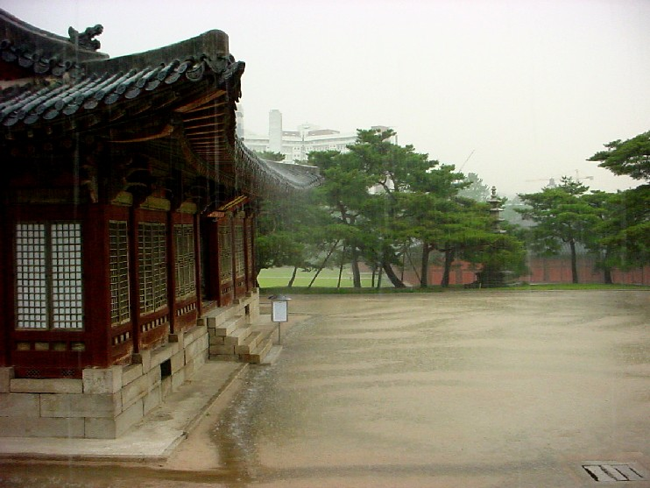
Monsoons
Southern and Southeast Asia have tropical monsoons that bring heavy rains for months at a time.
People in this region depend upon this seasonal rainfall for their crops and water supply.

Slide 16
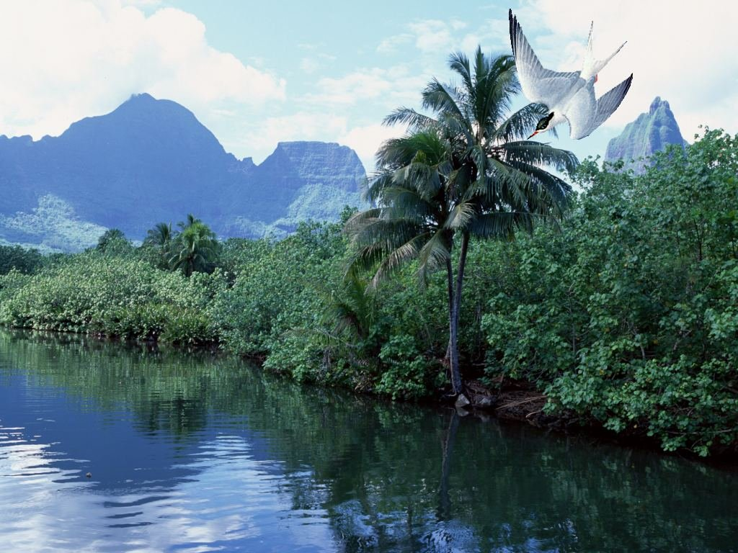
Asia’s Climates
Other parts of Asia have tropical, temperate, or arid climates.

Slide 17
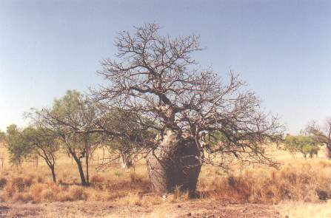
Asia’s Climates
Tropical climates have warm or hot temperatures year-round with fairly consistent amounts of rainfall.
Temperate climates have four seasons, with hot summers and cold winters.
Places with arid climates receive little rainfall, though temperatures can vary.

Slide 18
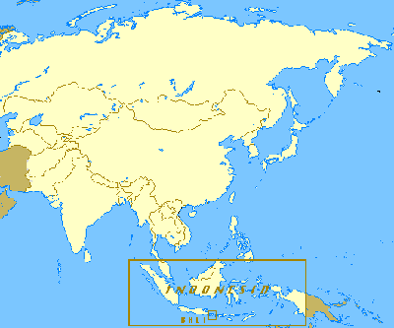
Archipelago
Several archipelagoes lie off of Asia’s coasts including Japan, the Philippines, Indonesia, and the Maldives.

